Slide 1
2020-2023 GLOBAL COVID-19 ANALYSIS REPORT
by Odunola Adewale
http://linkedin.com/in/odunola-adewale-52a4a8158
https://github.com/AnalystOdunola

Slide 2
DATASET OVERVIEW
The COVID-19 Analysis Dashboard presents global pandemic trends from 2020–2023 using interactive visualizations and KPI tracking. The dataset includes confirmed cases, recoveries, deaths, active cases, and daily growth trends across multiple countries and regions.
The dashboard was designed using a color-coded approach to improve readability and insight delivery. Blue represents confirmed cases and overall case trends, green represents recoveries and recovery rates, while red highlights deaths and critical growth indicators. These colors were selected to create clear visual separation between positive, neutral, and critical metrics.
Using Power BI, the raw data was transformed into an interactive dashboard featuring KPI cards, rolling averages, trend analysis, country comparisons, and map-based visualizations.
The dashboard was designed to provide a quick but detailed understanding of pandemic behavior by highlighting infection waves, recovery performance, mortality trends, and daily case movements across different periods of the outbreak.

Slide 3
BUSINESS PROBLEM
During the 2020–2023 COVID-19 outbreak, governments, health organizations, and decision-makers needed a clear way to track infection spread, recovery performance, and overall pandemic impact. However, most data was scattered across daily reports and difficult to interpret quickly.
The goal of this project was to build an interactive dashboard that simplifies COVID-19 analysis and answers three key questions:
Where are cases highest?
How fast is the virus spreading?
How effective are recovery efforts?

Slide 4
KPIs DEFINED
Total Cases: 104M confirmed cases globally
Total Recoveries: 31M recovered cases
Recovery Rate: 30%
Total Deaths: 1M recorded deaths
Active Cases: 72M active cases
Daily New Cases: 6.2M peak daily new cases recorded
7-Day Rolling Average: Used to identify short-term infection trends
14-Day Rolling Average: Used to monitor broader pandemic movement over time

Slide 5
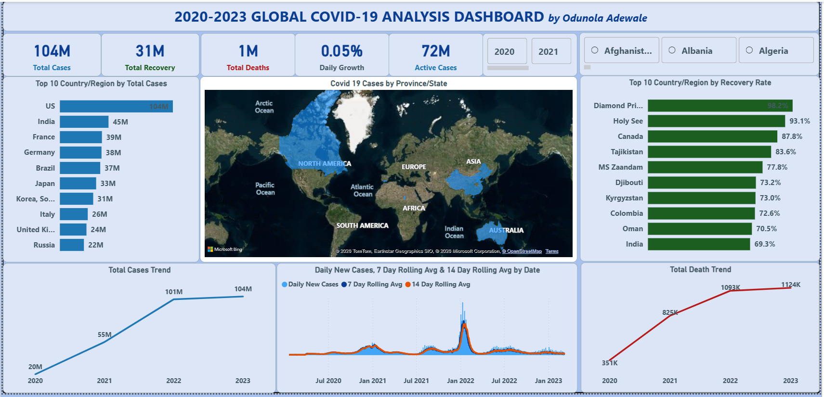
DASHBOARD SCREENSHOT

Slide 6
KEY INSIGHTS
The United States recorded the highest COVID-19 impact globally with over 104M confirmed cases, more than India’s 45M cases.
India, Brazil, France, and Germany also experienced significantly high infection volumes throughout the pandemic period.
Diamond Princess recorded one of the highest recovery rates at over 98%, while countries like India showed lower recovery performance around 69%.
Death trends increased steadily between 2020 and 2023, with the sharpest rise occurring around 2022 during major outbreak waves.
Growth rates slowed after 2022, likely due to vaccination programs, improved treatment methods, and reduced severity of later variants.
Rolling averages clearly highlighted the major Omicron surge in early 2022, which appeared less visible in raw daily case data.
Geographic analysis identified North America, China, and Australia as major hotspot regions with the highest confirmed case concentrations.

Slide 7
RECOMMENDATIONS
Focus resource allocation on the top 5 countries by confirmed cases: United States (104M), India (45M), France, Germany, and Brazil, as these countries account for a major share of global infections.
Study high recovery-rate regions such as Diamond Princess (98.2%) and Canada (87.8%) to better understand effective healthcare response strategies and recovery management practices.
Continue using 7-day and 14-day rolling averages for trend monitoring, since raw daily case figures are highly volatile and often affected by reporting delays and weekend lags.
Countries with lower recovery rates may require stronger healthcare interventions and resource allocation.
Early-warning monitoring systems should be developed around rapid growth spikes to respond faster to future outbreaks.
Governments should focus on improving data transparency and daily reporting consistency across regions.
Public health strategies should prioritize high-risk regions with consistently high active case volumes.

Slide 8
CHALLENGES FACED
Cleaning and transforming large COVID-19 datasets with inconsistent country and regional records.
Managing NULL and missing values across multiple reporting fields.
Learning how to use Unpivot in Power Query to properly restructure and prepare the dataset for analysis.
Initial confusion on whether certain measures were stored as decimals or percentages, causing formatting inconsistencies.
Difficulty creating accurate DAX measures for Daily New Cases and Daily Growth Rate calculations.
Building and configuring 7-day and 14-day rolling average measures for smoother trend analysis.
Balancing dashboard readability, visual design, and performance while working with multiple charts, maps, and KPI cards simultaneously.

Slide 9
CONCLUSION
The COVID-19 dashboard successfully transformed large volumes of global pandemic data into a clear and interactive analytical view. Through KPI tracking, geographic analysis, trend monitoring, and rolling averages, the dashboard provided deeper insight into how the virus spread, how recovery patterns differed across countries, and how infection waves evolved between 2020 and 2023.
The analysis revealed that while some countries managed recovery efforts effectively, others experienced significantly higher case growth and mortality impact. The use of 7-day and 14-day rolling averages also improved trend interpretation by reducing daily reporting volatility and exposing clearer long-term patterns.
Beyond visualization, the project reinforced the importance of data cleaning, data transformation, accurate DAX calculations, trend smoothing, and effective dashboard storytelling in transforming raw public health data into meaningful insights for decision-making.

